Slide 1
Welcome to Our Presentation

Slide 2
Comparative Study Between Quick Sort and Marge Sort

Slide 3
Group Members.
Name: Mahmodul Hasan
ID: 191-15-12933
Sec: 014
Name: Md. Tariqul Islam
ID: 191-15-12963
Sec: 014

Slide 4
Introduction.
An algorithm is a well define process to solve any problem. It takes some data as a input and make a output with these data. In mathematics and computer science, an algorithm usually means a logical image of the commands which must be performed significant activity. The main factor of analysis of algorithm is to study about time and space and their relationship between the algorithms necessities and number of elements or items being executed or processed. Generally sorting is the method of reorganizing a given set of data and objects within a particular arrangement.

Slide 5
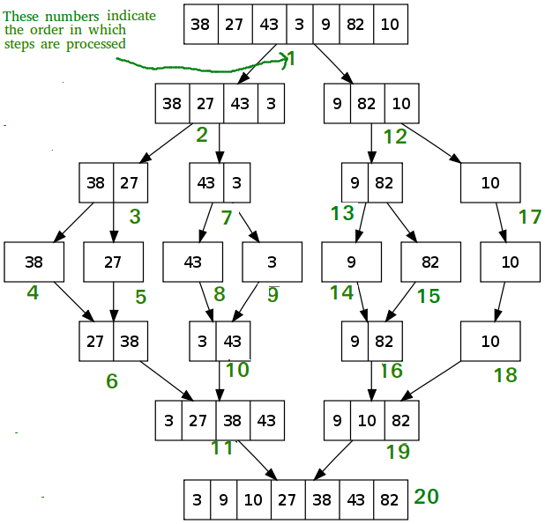
Marge Sort
Marge Sort(arr[],l,r)
{
Middle point m= (l+r)/2
Marge Sort (arr,l,m) //Call for first half
If(r>f)
Marge Sort(arr[],l,r){
Marge Sort (arr,m+1,r) //call for second half
Marge Sort( arr,l,m,r) // Marge the two parts
}

Slide 6
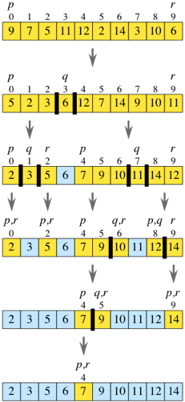
Quick Sort
QuickSort (arr [], low, high){
If( low<high){
Pi= partition (arr, low, high);//partitioning index. Arr[i]
Quicksort(arr,low,pi-1);//before index
Quicksort(arr,pi+1,high);//After index
}
}

Slide 7
Quick Sort VS Marge Sort
Time complexity
.
Quick Sort
Best Case: O( n log n)
Average case: O(n log n)
Worst Case: O(n^2)
Marge Sort
Best Case: O( n log n)
Average case: O( n log n)
Worst Case: O( n log n)
Works Well
Quick Sort
It works well in small array.
Marge Sort
It works well in any size of array.

Slide 8
Quick Sort VS Marge Sort
Speed Excision
.
Quick Sort
It work faster than other sorting algorithms for small data set like Selection sort etc.
Marge Sort
It has a consistent speed on any size of data.
Efficiency
Quick Sort
Working fast in small array.
Marge Sort
Working fast in large array.

Slide 9
Quick Sort VS Marge Sort
Sorting Method
.
Quick Sort
Internal sorting method. Use main memory.
Marge Sort
External sorting method. Need external memory.
Preferred For
Quick Sort
Preferred for array
Marge Sort
Preferred for link list.

Slide 10
Thank You.

